Slide 1

Welcome to
"An Evening with the Future of The ASP!"
Click!
The President of Asian Society for Psoriasis
OZAWA Akira, M.D. & Ph.D. (Tokai University, JAPAN)
Oct. 24, 2022, The Imperial Hotel Tokyo, JAPAN

Slide 2

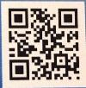
Good Evening !
Thank you very much for joining us
today for "An Evening to Think about
the Future of the Asian Society for
Psoriasis (ASP)".
To start the meeting, we would like
to begin by looking back at the path
that The ASP has taken so far.
URL http://asp.umin.jp/

Slide 3

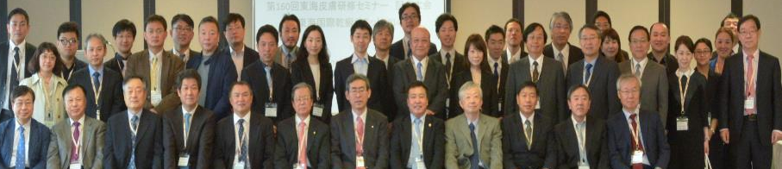
2 0 1 4
Tokai International Psoriasis Summit 2014 (TIPS 2014), Tokyo, JAPAN
〇 To Know Others and To Do Something Together !
〇 President : Dr.OZAWA Akira, M.D. & Ph.D.
Secretary General : Dr.MABUCHI Tomotaka, M.D. & Ph.D.
Secretaries : Drs.SONG (Korea), FAN(China),
SINDHVANANDA (Thailand) & DINO(Chinese Taipei）.
〇 105 participants : 72 Japanese, 18 Korean, 9 Chinese,
4 Chinese Taipei, 1 Thailand & 1 American.

Slide 4
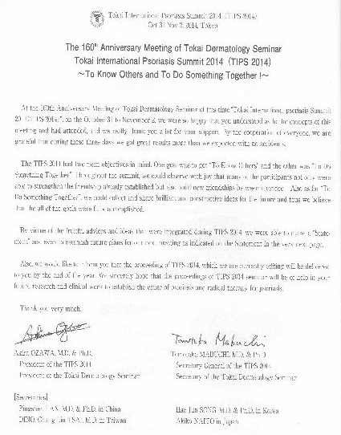
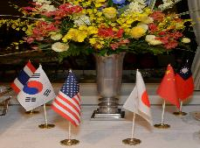
2 0 1 4
Tokai International Psoriasis Summit 2014 (TIPS 2014), Tokyo, JAPAN

Slide 5
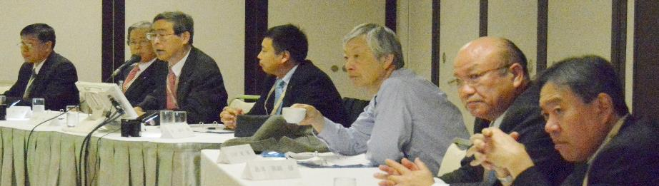
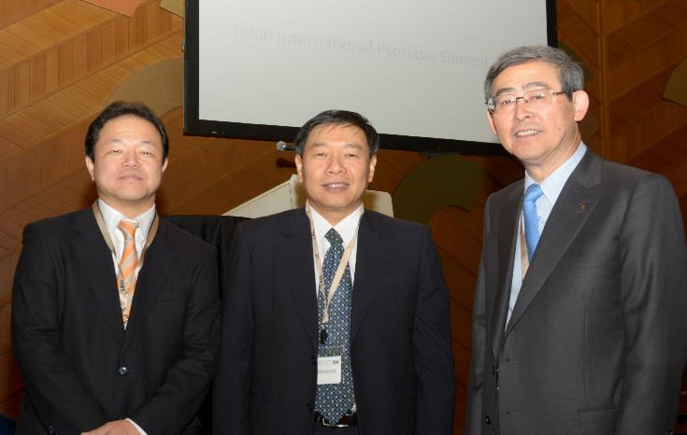
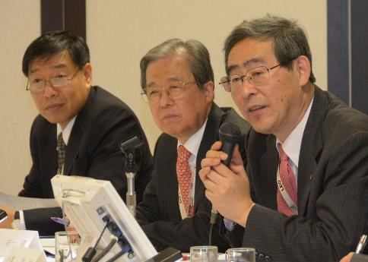
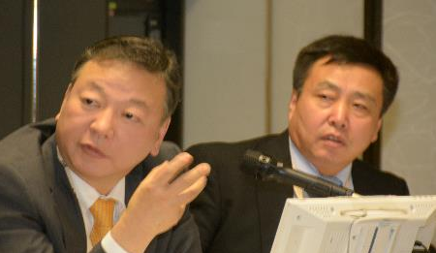
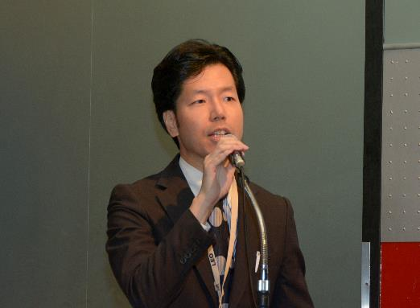
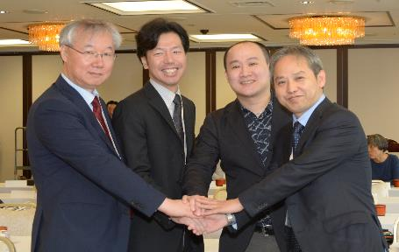
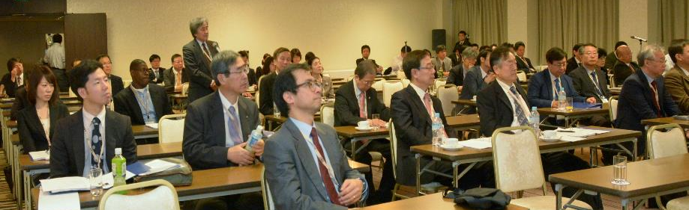
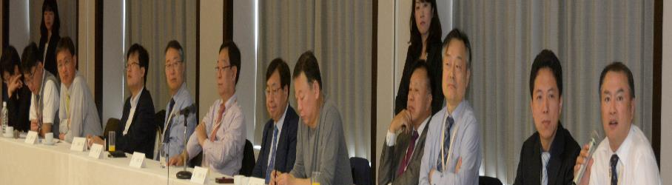
2 0 1 4
Tokai International Psoriasis Summit 2014 (TIPS 2014), Tokyo, JAPAN

Slide 6
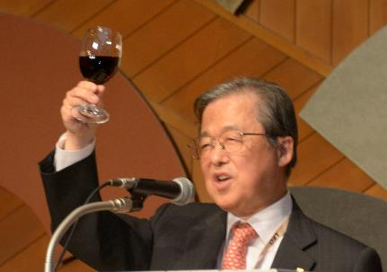
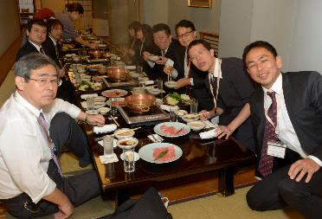
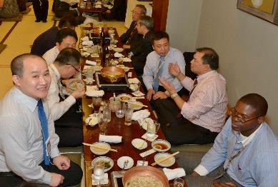
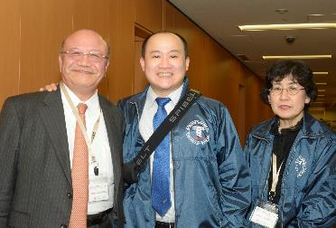
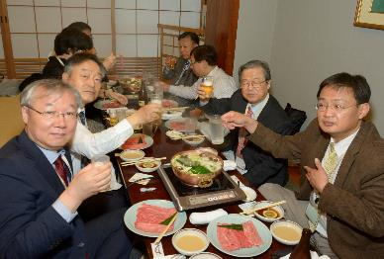
2 0 1 4
Tokai International Psoriasis Summit 2014 (TIPS 2014), Tokyo, JAPAN

Slide 7
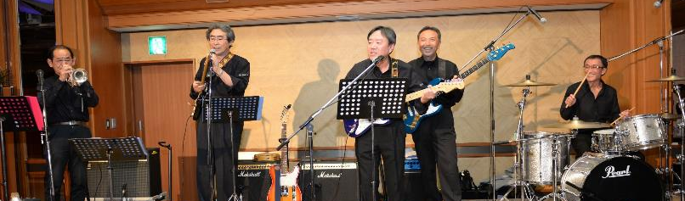
2 0 1 4
Tokai International Psoriasis Summit 2014 (TIPS 2014), Tokyo, JAPAN
Let’s SING !!
International Song Festival
in Dermatology
１) Prof. Jai Il YOUN
２) Prof. Tae Yoon KIM
3) Dr. Ying-Jui CHANG
4) Prof. Jianzhhoug ZHANG
5) Prof. Tadashi TERUI
6) Dr. Ping-Shen FAN
7) Prof. Nack In KIM
8) Dr. Dino TSAI
9) Prof. Mitsuru SETOYAMA
10) Prof. Hae Jun SONG
11) Prof. Shigaku IKEDA
Mrs. Sachiko IKEDA
The Professors
〜The TIPS 2014〜
Nov 1, 2014, Tokai University Club, Tokyo

Slide 8
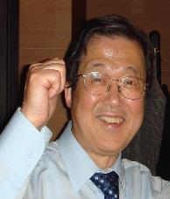
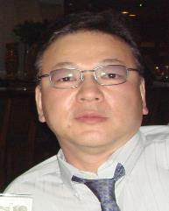
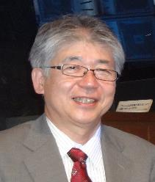
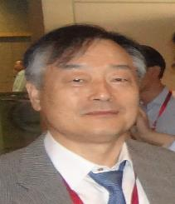
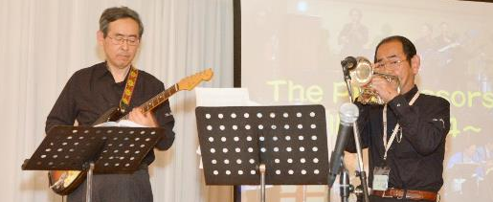
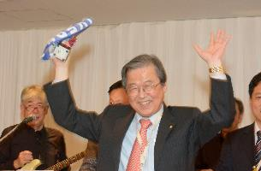

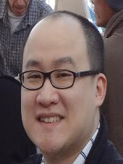
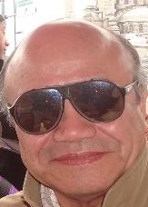
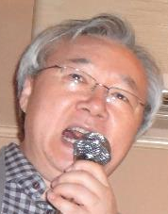
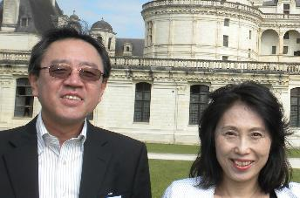

2 0 1 4
Tokai International Psoriasis Summit 2014 (TIPS 2014), Tokyo, JAPAN

Slide 9
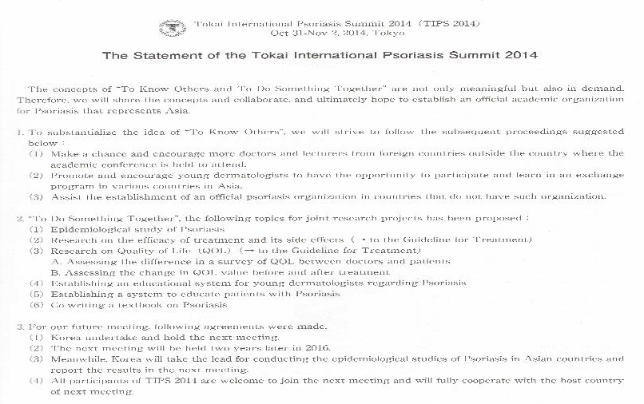
2 0 1 4
Tokai International Psoriasis Summit 2014 (TIPS 2014), Tokyo, JAPAN
This like meeting
will be held
in each 2 years.

Slide 10

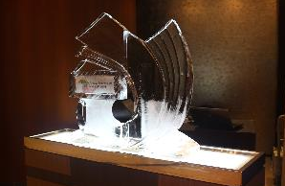
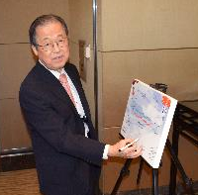
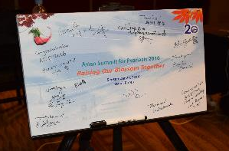
2 0 1 6
Asian Summit for Psoriasis 2016 (ASP 2016), Seoul, Korea
〇 Rising Our Blossom Together !
〇 President : Dr.YOUN Jai Il, M.D. & Ph.D.
Secretary General : Dr.SONG Hae Jun, M.D. & Ph.D.
Secretaries : Drs.MABUCHI (Japan), FAN (China),
SINDHVANANDA(Thailand) and DINO(Chinese Taipei).
〇 102 participants : 75 Korean, 12 Japanese, 9 Chinese,
4 Chinese Taipei, 1 Thailand & 3 Mongolians.
〇 Supported by the KSP & the KDA.

Slide 11
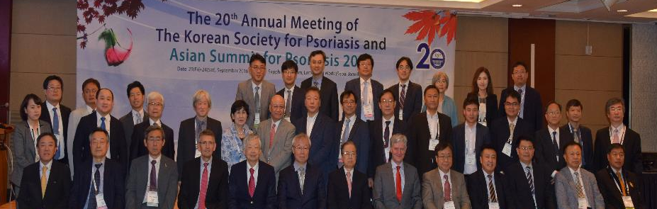
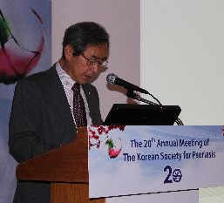
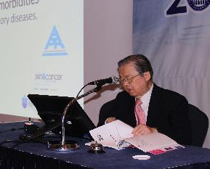
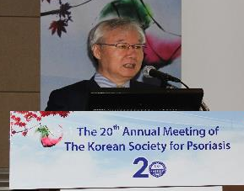
2 0 1 6
Asian Summit for Psoriasis 2016 (ASP 2016), Seoul, Korea

Slide 12
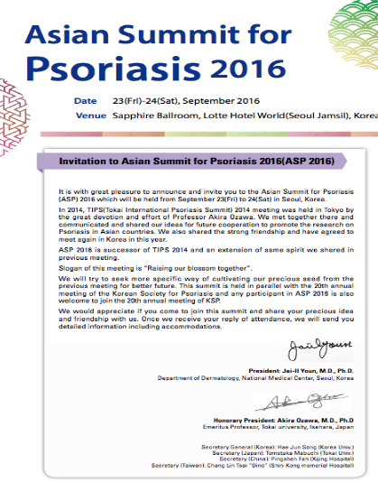
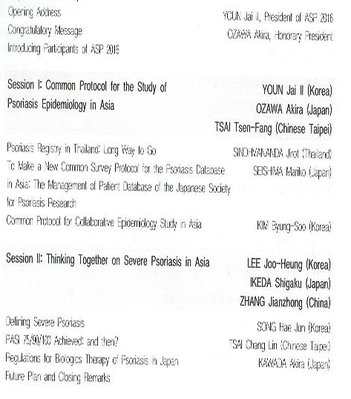
2 0 1 6
Asian Summit for Psoriasis 2016 (ASP 2016), Seoul, Korea

Slide 13
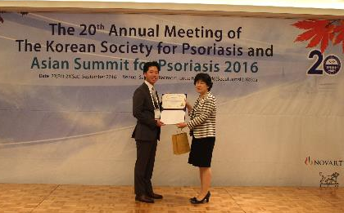
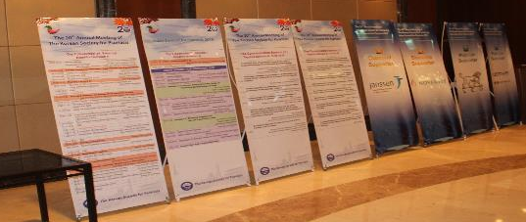
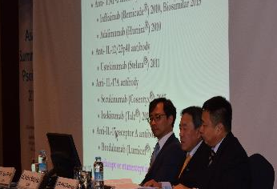
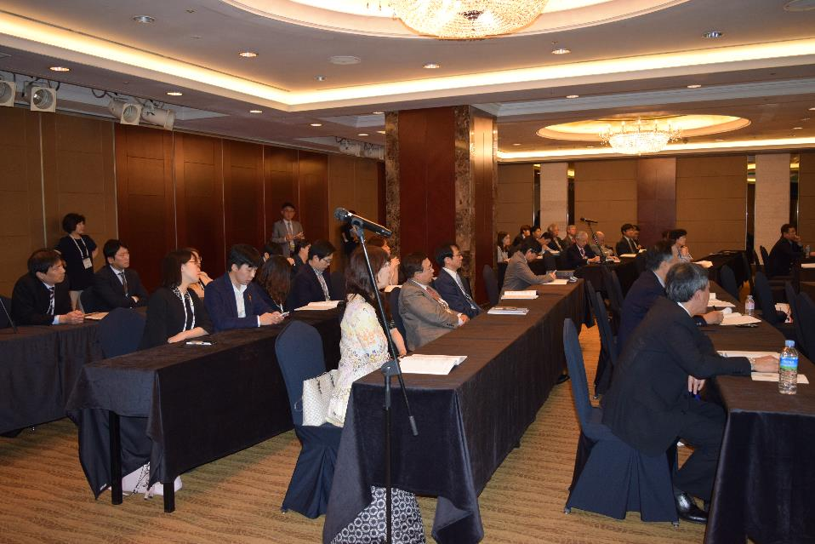
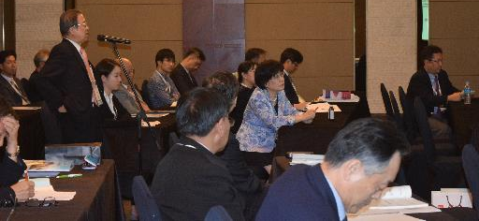
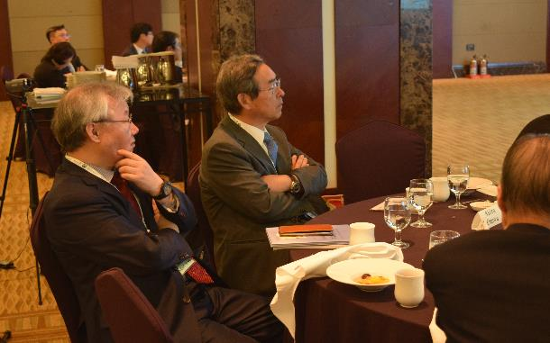
2 0 1 6
Asian Summit for Psoriasis 2016 (ASP 2016), Seoul, Korea

Slide 14
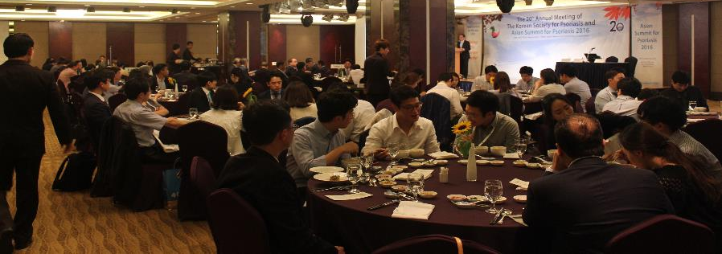
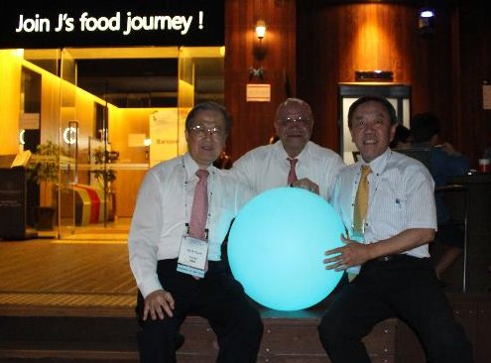
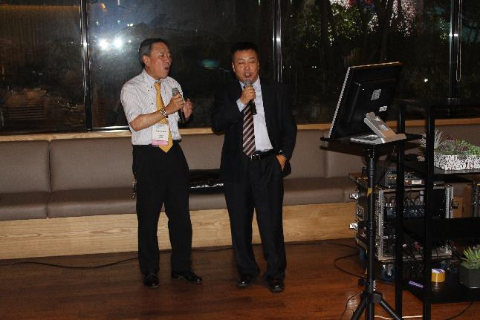
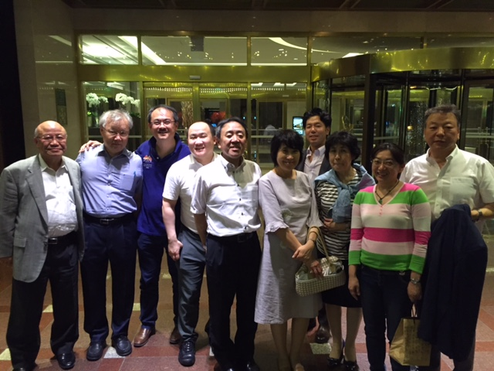
2 0 1 6
Asian Summit for Psoriasis 2016 (ASP 2016), Seoul, Korea

Slide 15

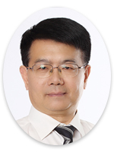
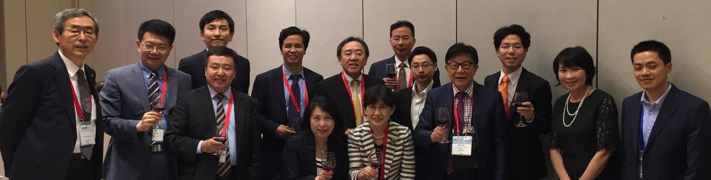
2 0 1 8
EADC International Psoriasis Symposium 2018 (IPS 2018)、Kunming, China
〇 President : Dr.ZHENG Min, M.D. & Ph.D.
〇 104 participants : 80 Chinese, 13 Japanese,
8 Korean, & 3 Chinese Taipei.
〇 Supported by The 5th EADC
& Chinese Society of Dermatology (CSD)

Slide 16

2 0 1 8
EADC International Psoriasis Symposium 2018 (IPS 2018)、Kunming, China

Slide 17

2 0 1 8
EADC International Psoriasis Symposium 2018 (IPS 2018)、Kunming, China

Slide 18




2 0 1 8
EADC International Psoriasis Symposium 2018 (IPS 2018)、Kunming, China

Slide 19

2 0 1 8
The Asian Society for Psoriasis
Pre-meeting for the Summit for Psoriasis in Asia 2020
〜December 7th〜8th, 2018, Beijing, China 〜
<P.R. China>
1. ZHANG Jianzhong, M.D. & Ph.D.
2. ZHENG Min, M.D. & Ph.D.
3. WANG Gang, M.D. & Ph.D.
4. FAN Pingshen, M.D. & Ph.D.
<Thailand>
1. SINDHVANANDA Jirot, M.D.
<Chinese Taipei>
1. TSAI Dino, M.D.
<Japan>
1. OZAWA Akira, M.D. & Ph.D.
2. MABUCHI Tomotaka, M.D. & Ph.D.
3. TOKUYAMA Michio, M.D.
<Korea>
1. YOUN Jai Il, M.D. and Ph. D.
2. SONG Hae Jun, M.D. & Ph.D.
From the left ; Drs.FAN, WANG, ZHANG, YOUN, ZHENG, OZAWA,
SONG, SINDHVANANDA, MABUCHI, TSAI & TOKUYAMA

Slide 20
CONCEPT
The Concept of “the Asian Society for Psoriasis” is
“To Know Others and To Do Something Together”,
and it is not only meaningful, but also in demand.
Therefore, we will share the concepts and collaborate,
and ultimately hope to establish an official academic organization for Psoriasis that represent Asia.

Slide 21







2022
The Vice President
The Vice President
SONG Hae Jun, M.D. & Ph.D.
WANG Gang, M.D. & Ph.D.
The President
OZAWA Akira, M.D. & Ph.D.
The Vice President
The Vice President
SINDHVANANDA Jirot, M.D.
MABUCHI Tomotaka, M.D. & Ph.D.
The Vice President
TSAI Dino, M.D.

Slide 22


















2022
The Honorary President
YOUN Jai Il, M.D. & Ph.D.
The Honorary Advisor
ZHENG Min, M.D. & Ph.D.
CHEN Hong-Duo, M.D. & Ph.D.
LU Qianjin, M.D. & Ph.D.
CHANG Ying-Jui M.D. & Ph.D
ZHANG Jianzhong, M.D. & Ph.D.
LIAO Wanqing, Ph.D.
HWANG Sam T., M.D. & Ph.D.
KIM Nack In, M.D. & Ph.D.
KIM Tae Yoon, M.D. & Ph.D.
CHOI Jee-Ho, M.D. & Ph.D.
LEE Joo Heung, M.D. & Ph.D.
PARK Chul Jong M.D. & Ph.D.
KIM Kwang Joong, M.D. & Ph.D.
SETOYAMA Mitsuru, M.D. & Ph.D.
NAKAYAMA Juichiro, M.D. & Ph.D.
OHTSUKI Mamitaro, M.D. & Ph.D.
NAKAGAWA Hidemi, M.D. & Ph.D.
KAWADA Akira, M.D. & Ph.D.

Slide 23






2022
The Special Advisor
ZHANG Xeujun, M.D. & Ph.D.
CHOE Yong Beom, M.D. & Ph.D.
AMAGAI Masayuki, M.D. & Ph.D.
GAO Xing Hua, M.D. & Ph.D.
PARK Chun Wook, M.D. & Ph.D.
MORITA Akimichi, M.D. & Ph.D.

Slide 24





2022
Secretary
The Secretary (CHINA)
FAN Pingshen, M.D. & Ph.D.
The Secretary (CHINESE TAIPEI)
TSAI Dino, M.D.
The Secretary General
MABUCHI Tomotaka, M.D. & Ph.D.
The Secretary (THAILAND)
SINDHVANANDA Jirot, M.D.
The Secretary (JAPAN)
TOKUYAMA Michio, M.D.
The Secretary (KOREA)
KIM Byung Soo, M.D. & Ph.D.

Slide 25
















2022
The Directors
（CHINA）
GU Heng, M.D. & Ph.D.
REN Yunqing, M.D. & Ph.D.
SHI Yuling, M.D. & Ph.D.
ZHAO Yi, M.D. & Ph.D.
ZHANG Xibao, M.D. , M.S. & Ph.D.
SUN Qing, M.D. & Ph.D.
LIU Xiaoming, M.D. & Ph.D.
XIA Lixin, M.D. & Ph.D.
YANG Bin, M.D.
CHEN Xiang, M.D. & Ph.D.
MAN Xiao-Yong, M.D. & Ph.D.
HAN Gangwen, M.D.
JIN Hongzhong, M.D. & Ph.D.
WANG Honglin, M.D. & Ph.D.
HE yanling, M.D. & Ph.D.
LAY Yuping, B.S.
GU Jun, M.D. & Ph.D.

Slide 26















2022
The Directors
（KOREA）
YOUN Song Woong, M.D. & Ph.D.
SHIN Bong Seok, M.D. & Ph.D.
KIM Dong Hyun, M.D. & Ph.D.
JO Seongjin, M.D. & Ph.D.
（CHINESE
TAIPEI）
PARK Hai JIn, M.D. & Ph.D.
ROH Joo Young, M.D. & Ph.D.
LO Yuan-Hsin, M.D. & Ph.D.
BYUN Ji Yeon, M.D. & Ph.D.
(THAILAND)
SUTHIPIITTHAR Pusan, M.D. & Ph.D.
ASAWANONDA Pravit, M.D. & DSc.
AUNHACHOKE Kobkul, M.D.
PATTAMADILOK Bensachee, M.D.
RAJATANAVIN Natta M.D. & Ph.D.
WONGPRAPARUT Chanisada, M.D.
MEEPHANSAN Jitlada M.D., M.Sc. & Ph.D.

Slide 27














2022
The Directors
（Japan）
SEISHIMA Mariko, M.D. & Ph.D.
TERUI Tadashi, M.D. & Ph.D.
IKEDA Shigaku, M.D. & Ph.D.
SAYAMA Koji, M.D. & Ph.D.
AMANO Masahiro, M.D. & Ph.D.
KATOH Norito, M.D. & Ph.D.
YAMANAKA Keiichi, M.D. & Ph.D.
YAMAMOTO Toshikuki, M.D. & Ph.D.
KANEKURA Takuro, M.D. & Ph.D.
IMAFUKU Shinichi, M.D. & Ph.D.
SAEKI Hidehisa, M.D. & Ph.D.
TADA Yayoi, M.D. & Ph.D.
KOMINE Mayumi, M.D. & Ph.D.
ASAHINA Akihiko, M.D. & Ph.D.

Slide 28


＜Home Page & Version Up＞
Aug. 01, 2019 Website was opened (The 1st version)
Apr. 01, 2020 Website was revised (The 2nd version)
Aug. 01, 2020 Website was revised (The 3rd version)
Jan. 01, 2021 Website was revised (The 4th version)
June 15, 2021 Website was revised (The 5th version)
Aug. 01, 2021 Website was revised (The 6th version)
Dec. 20, 2021 Website was revised (The 7th version)
Mar. 14, 2022 Website was revised (The 8th version)
May 31, 2022 Website was revised (The 9th version)
URL http://asp.umin.jp/

Slide 29
Results of the Epidemiological Investigation
(approved by the Ethics Committee as of December 31, 2020)
The Results for the ASP Investigation in 2020 & 2021
＜in The Homepage of ASP＞
The Special Project 2 : "Topics on Psoriasis in Asia"
The 121st Annual Meeting of the Japanese Dermatological Association,
Kyoto, Japan, June 4 (Sat), 2022
Epidemiological survey of psoriasis in the Asian Society for Psoriasis from 2020 to 2021
The 12th Asian Dermatological Congress (ADC),
Tokyo, Japan, August 4 (Fri)〜5 (Sat), 2022
Psoriasis in Asia from the Project of the ASP 2020〜2022
The ASP Tokyo 2022, Tokyo, Japan, November 26 (Sat)〜27 (Sun), 2022

Slide 30

The 1st Asian Society Psoriasis 2020 TOKYO
(The 1st ASP 2020 Tokyo )
Date November ７〜８, 2020
Venue Tokyo, JAPAN
President Dr. MABUCHI Tomotaka
(The Vice President of the ASP,
Tokai University, Isehara, JAPAN
Secretary Dr. TOKUYAMA Michio
(The Secretary in Japan of the ASP,
Tokai University, Isehara, JAPAN
However, due to the global spread of
the COVID-19, it was postponed to
"The 1st ASP 2021 Tokyo".
Tokyo 2020

Slide 31
The 1st Asian Society Psoriasis 2021 Tokyo
(The 1st ASP 2021 TOKYO)
Date November, 2021
Venue Tokyo, JAPAN
President Dr. MABUCHI Tomotaka
(The Vice President of the ASP,
Tokai University, Isehara, JAPAN
Secretary Dr. TOKUYAMA Michio
(The Secretary in Japan of the ASP,
Tokai University, Isehara, JAPAN
However, due to the global spread of the COVID-19, it was again postponed to "The 1st ASP 2022 Tokyo".
Tokyo 2021

Slide 32



Slide 33
Thank you for your attention!
You have seen The ASP's path to date.
So, in light of this, and in order to "consider the path that The ASP should take in the future," we would like to report on the items approved
by the Board of Directors for The ASP beginning in FY2023.
The Asian Society for Psoriasis (ASP)

Slide 34
Results of Board Meeting 2022
Resolved Item 1
Approval of reappointment of
all Special Advisors and all Directors for FY2022
Resolved Item 2
Dr. OZAWA Akira as President of the ASP
for two years from FY2023
Resolved Item 3
Approval of new Special Advisors and Directors for two years from FY2023

Slide 35



2 0 2 3
The Special Advisors
The President
ETOH Takafumi, M.D.
(JAPAN)
OZAWA Akira, M.D. & Ph.D.
(JAPAN)
ASAWANONDA Pravit, M.D. & DSc.
(THAILAND)

Slide 36






2 0 2 3
The Directors
（KOREA）
LEE Eun So, M.D. & Ph.D.
JEONG Kiheon, M.D. & Ph.D.
BAEK Yoo Sang, M.D. & Ph.D.
No Photo
Dr. BANG Chul Hwan
No Reply
JUNG Kyungeun, M.D. & Ph.D.
PARK Eun Joo, Ph.D.
Dr. Yu Sung Choi
Dr. KIM Tae Gyun
KIM Jeong Eun, M.D. & Ph.D.

Slide 37










2 0 2 3
The Directors
（JAPAN）
FUJIMOTO Manabu, M.D & Ph.D.
TSURUTA Daisuke, M.D & Ph.D.
OKUYAMA Ryuhei, M.D & Ph.D.
ARAI Satoru, M.D & Ph.D.
SUGAI Junichi, M.D & Ph.D.
YAMAZAKI Fumikazu, M.D & Ph.D.
OKUBO Yukai, M.D & Ph.D.
SHIBATA Sayaka, M.D & Ph.D.
YASUDA Masato, M.D & Ph.D.
SUGIURA Kazumitsu, M.D & Ph.D.

Slide 38



2 0 2 3
The Directors
（CHINA）
Dr. ZHANG Chunlei, M.D. & Ph.D.
Dr. XIA Yumin, M.D. & Ph.D.
Dr. SHAO Shuai, M.D. & Ph.D.
No Photo
No Reply
The Directors
（THAILAND）
Dr. QIAO Jianjun
Dr. KUANG Yehong
Dr. HANG Li
Dr. WANG Mingyue
Dr. CHEN Jia-Qi
Dr. CAI Lin
No Reply
Dr. PLOYSYNloysyne Busaracome

Slide 39
The Board Members of
the Asian Society for Psoriasis (2023〜)
 | Honorary President | Honorary Advisor | Special Advisor | Director | Total
CHINA | １ | ４ | ２ | ２7 | 34
KOREA | １ | ５ | ２ | 26 | 34
JAPAN | ０ | ６ | ３ | 30 | 39
CHINESE TAIPEI | ０ | １ | ０ | ２ | 3
THAILAND | ０ | ０ | 1 | 9 | 10
U.S.A | ０ | １ | ０ | ０ | 1

Slide 40
Results of Board Meeting 2022
〜Resolved Item 4〜
Number of Directors : 55
Voting : 43 (78.2%)
The President of the 2nd ASP 2024 & the 3rd ASP 2026
The Vice President (CHINA)
WANG Gang, M.D. & Ph.D.
The Special Advisor (KOREA)
CHOE Yong Beom, M.D. & Ph.D.

Slide 41
2 0 2 4
The President of the 2nd ASP 2024 & the 3rd ASP 2026
21
(48.8%)
The Vice President (CHINA)
WANG Gang, M.D. & Ph.D.
22
(51.2%)
The Special Advisor (KOREA)
CHOE Yong Beom, M.D. & Ph.D.

Slide 42
The President of the NEXT ASP
2 0 2 4
2 0 2 4
2 0 2 6
Dr. CHOE Yong Beom,
Congratulations!
Please come to
the stage and say hello.
KOREA
CHINA
The Special Advisor
CHOE Yong Beom, M.D. & Ph.D.
The Vice President
WANG Gang, M.D. & Ph.D.

Slide 43
Produced by OZAWA Akira (Tokai University JAPAN), 2022
BGM The Professors ( TIPS 2014, Nov.1, 2014, Tokyo, JAPAN)
・The Bitter Sweet Samba
Tp : OZAWA Hisashi, G : OZAWA Akira, B : TAKEHARA Hiroshi & Ds KOBAYASHI Masakazu
・The Taste of Honey
Tp : OZAWA Hisashi, G : OZAWA Akira, B : TAKEHARA Hiroshi & Ds KOBAYASHI Masakazu
・Diana
Vo : Y0UN Jai Il & IKEDA Shigaku, G : OZAWA Akira, B : TAKEHARA Hiroshi & Ds KOBAYASHI Masakazu
・Seishunn-jidai
Vo : IKEDA Shigaku & TERUI Tadashi, G : OZAWA Akira, B : TAKEHARA Hiroshi & Ds KOBAYASHI Masakazu
・TSUNAMI
Vo : IKEDA Shigaku, Tp : OZAWA Hisashi, G : OZAWA Akira, B : TAKEHARA Hiroshi & Ds KOBAYASHI Masakazu
・The House of the Rising Sun
Vo : IKEDA Shigaku & TERUI Tadashi, Tp : OZAWA Hisashi, G : KITAJIMA SAYUO & OZAWA Akira, B : TAKEHARA Hiroshi
& Ds KOBAYASHI Masakazu
・The Girl from Ipanema
Tp : OZAWA Hisashi, G : OZAWA Akira, B : TAKEHARA Hiroshi & Ds KOBAYASHI Masakazu

Slide 44
Thank you very much for your attention.

